Slide 1
Launch of Advancing global health and strengthening the HIV response in the era of the Sustainable Development Goals: the International AIDS Society– Lancet Commission

Slide 3
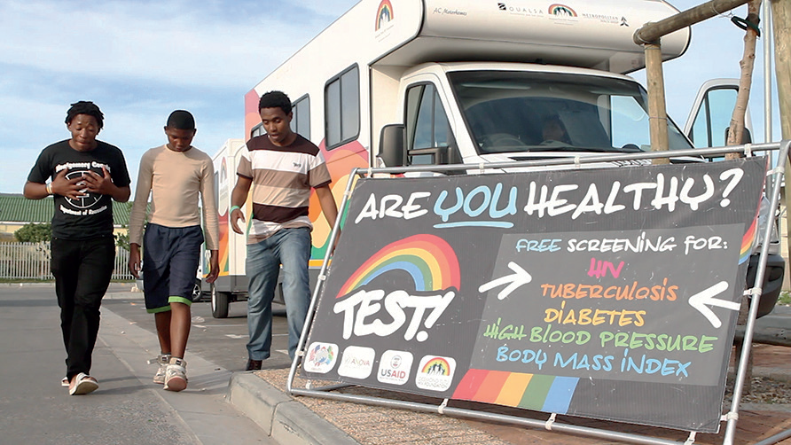
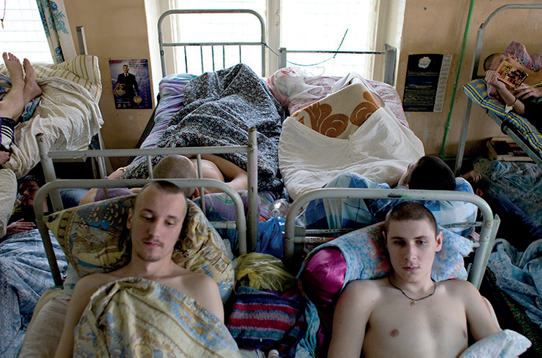

Slide 4
URGENT EFFORTS ARE NEEDED TO REJUVENATE A FLAGGING HIV RESPONSE
Notes:
International HIV assistance is declining and domestic spending on HIV is flagging
A resurgence of the epidemic is likely without further reductions in HIV incidence, especially as the largest-ever generation of young people age into adolescence and adulthood

Slide 5
PROVIDE INTEGRATED, CO-LOCATED SERVICES FOR HIV AND RELATED HEALTH CONDITIONS
Notes:
Many diseases and disease areas are closely related to HIV in that they share routes of transmission, have overlapping groups at high risk and/or commonly occur as co-morbidities in people living with HIV.

Slide 6
INTEGRATE SERVICES FOR CHRONICALLY UNDERSERVED POPULATIONS
Notes:
For marginalized and/or underserved populations, a promising approach to integration is to cluster a range of services tailored to each population’s needs in the same service site

Slide 7
LEVERAGE HIV PLATFORMS TO INTEGRATE SERVICES FOR HIV AND NCDS
Notes:
The long-term care of people living with HIV will increasingly focus on the prevention and management of non-communicable diseases (NCDs).

Slide 8
THE HIV RESPONSE MUST JOIN WITH THE BROADER GLOBAL HEALTH FIELD TO USHER IN A NEW ERA OF GLOBAL HEALTH SOLIDARITY
Notes:
Projections indicate that available financing for health is likely to fall far short of amounts needed to achieve the health targets in the SDGs

Slide 9
Acknowledgements
Pamela Das & Richard Horton

Slide 10
Launch of Advancing global health and strengthening the HIV response in the era of the Sustainable Development Goals: the International AIDS Society– Lancet Commission

